Slide 1

10 Opinions For Creating More Maintainable .NET Apps
Slides up at scottsauber.com
scottsauber

Slide 2

Audience
Existing .NET Developers
Desire for more maintainable solutons
scottsauber

Slide 3
Audience Goals
“New” perspective on a few topics
You’re not going to agree on everything
Take away some ideas to evaluate in your future workflow tomorrow
scottsauber

Slide 4


Who am I?
Director of Engineering at Lean TECHniques
Co-organizer of Iowa .NET User Group
Blog at scottsauber.com
scottsauber

Slide 5
Agenda
Lightning Talk approach
Talk about best practices for all these
Folder Structure
Don’t use IOptions Directly
Code Flow
Validation
ORM’s
Dependency Injection
Unit Testing and Assertions
DevOps
Feature Toggles
Microservices
scottsauber
Notes:
I find I get most bang for my buck getting a 5 min Lightning Talk from someone on a topic, so that’s what this is.
<after talking about all these> BINGO

Slide 6
Overall theme
Improve Maintainability
Better practices
Consistency
Enjoyable to work with
The point of software is to sustainably minimize lead time to business impact
“Legacy software is software you have no confidence in.”
scottsauber

Slide 7
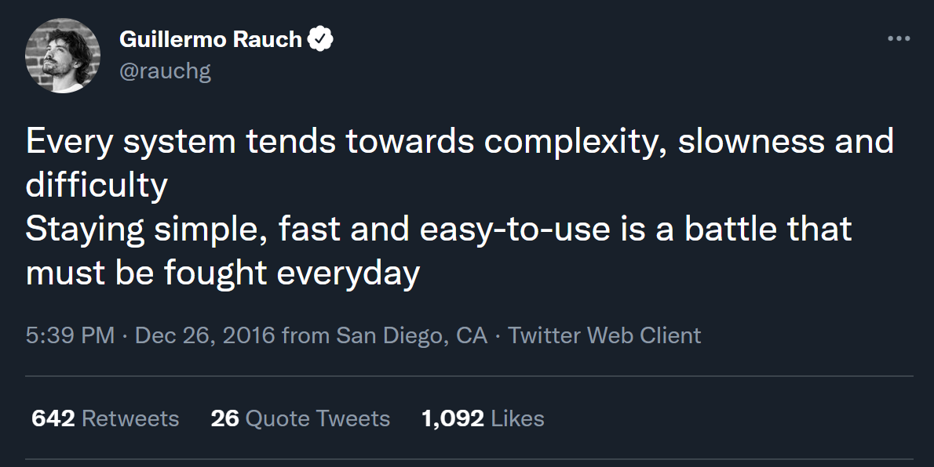

Slide 8
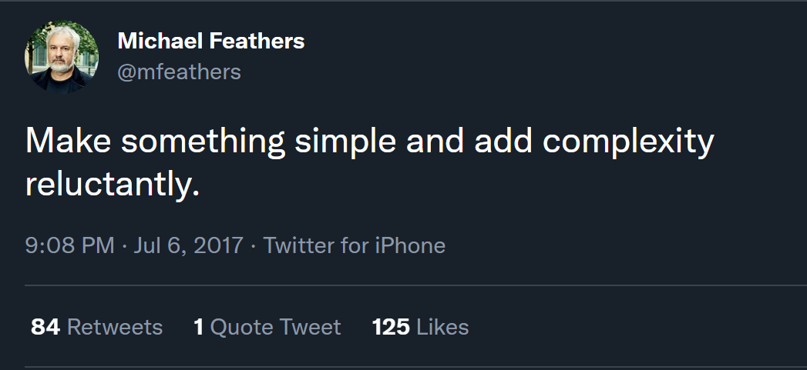

Slide 9
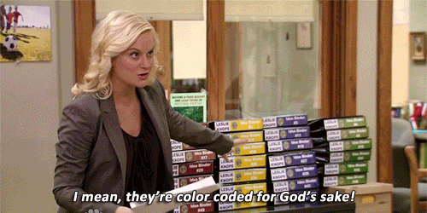
Folder Structure

Slide 10
Problem: OOB MVC Folders By Responsibility
All of these live in their own separate folders and most are required to add a new feature
Controllers
Views
Models
wwwroot/css
wwwroot/js
Adds navigation friction
Scope of a feature is scattered
Makes it hard to add, delete or extend existing features
scottsauber

Slide 11
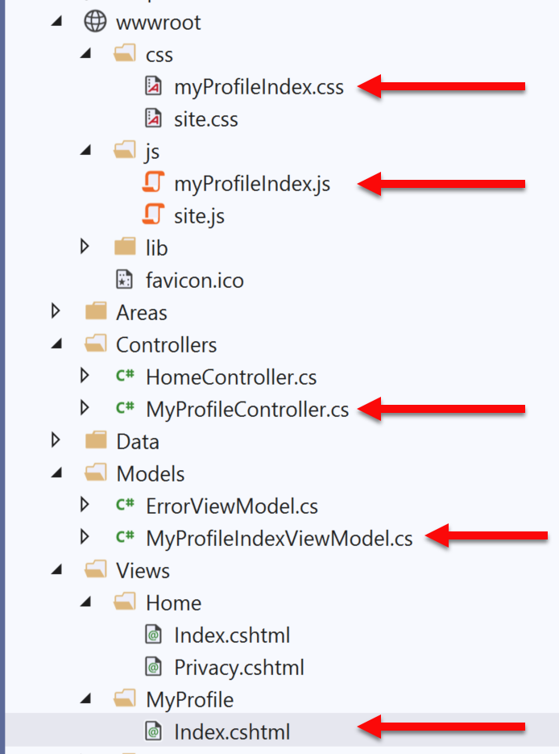
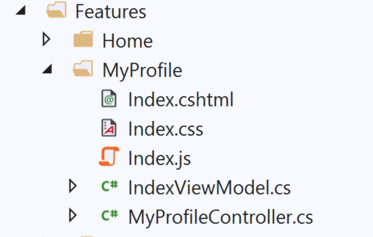
Solution: Use Feature Folders
Grouping by Feature, not by Responsibility, results in easier maintenance
Related things remain together (High Cohesion)
MVC out of the box:
Feature Folders:

Slide 12
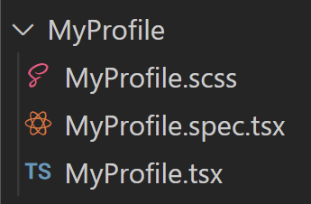
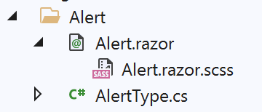
Solution: Use Feature Folders
React:
Blazor:
scottsauber
Notes:
Some even put tests in their feature folders

Slide 13
Feature Folder Extra Resources
How to do this in ASP.NET Core
My blog post
Steve Smith’s Blog on Feature Folders vs. Areas
Also used in React, Angular, etc.
Refactoring to Vertical Slice architecture (featureFolders++)
Derek Comartin
scottsauber

Slide 14
Questions on Feature Folders?
scottsauber

Slide 15
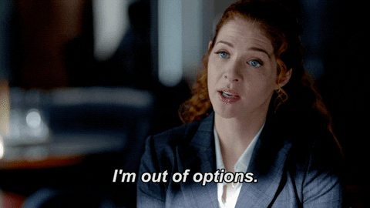
Don’t use IOptions… Directly

Slide 16
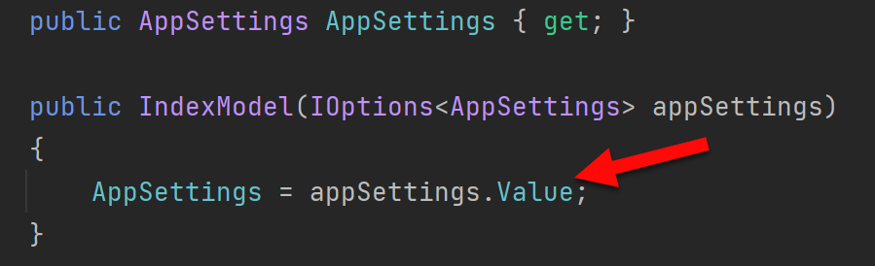
Problem: IOptions is annoying
Dependency on Microsoft.Extensions.Options down in other csproj’s
.Value everywhere adds friction
Testing IOptions is slightly annoying with Options.Create()
scottsauber

Slide 17
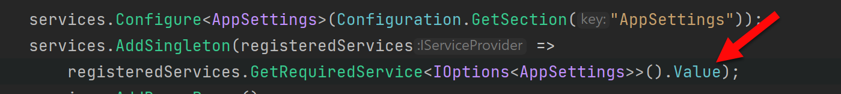
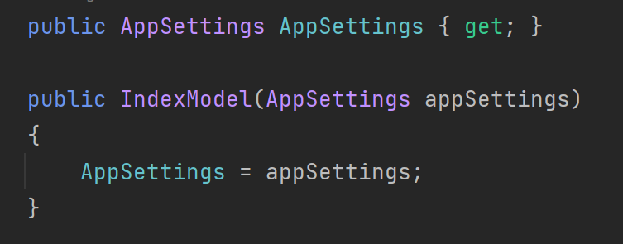
Solution: Register your Options class directly
scottsauber

Slide 18
Questions on IOptions?

Slide 19
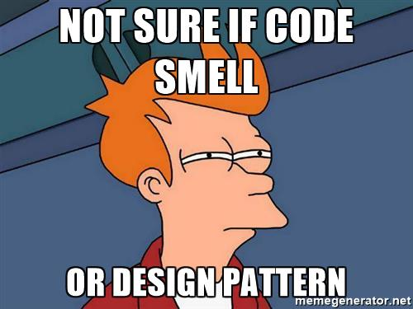
Code Smells

Slide 20
Structuring a method
Happy Path always at the bottom of the method
Don’t want to scan for “what happens when all goes well” and find it in the middle of a method
Use return’s instead of nested if => else
scottsauber

Slide 21
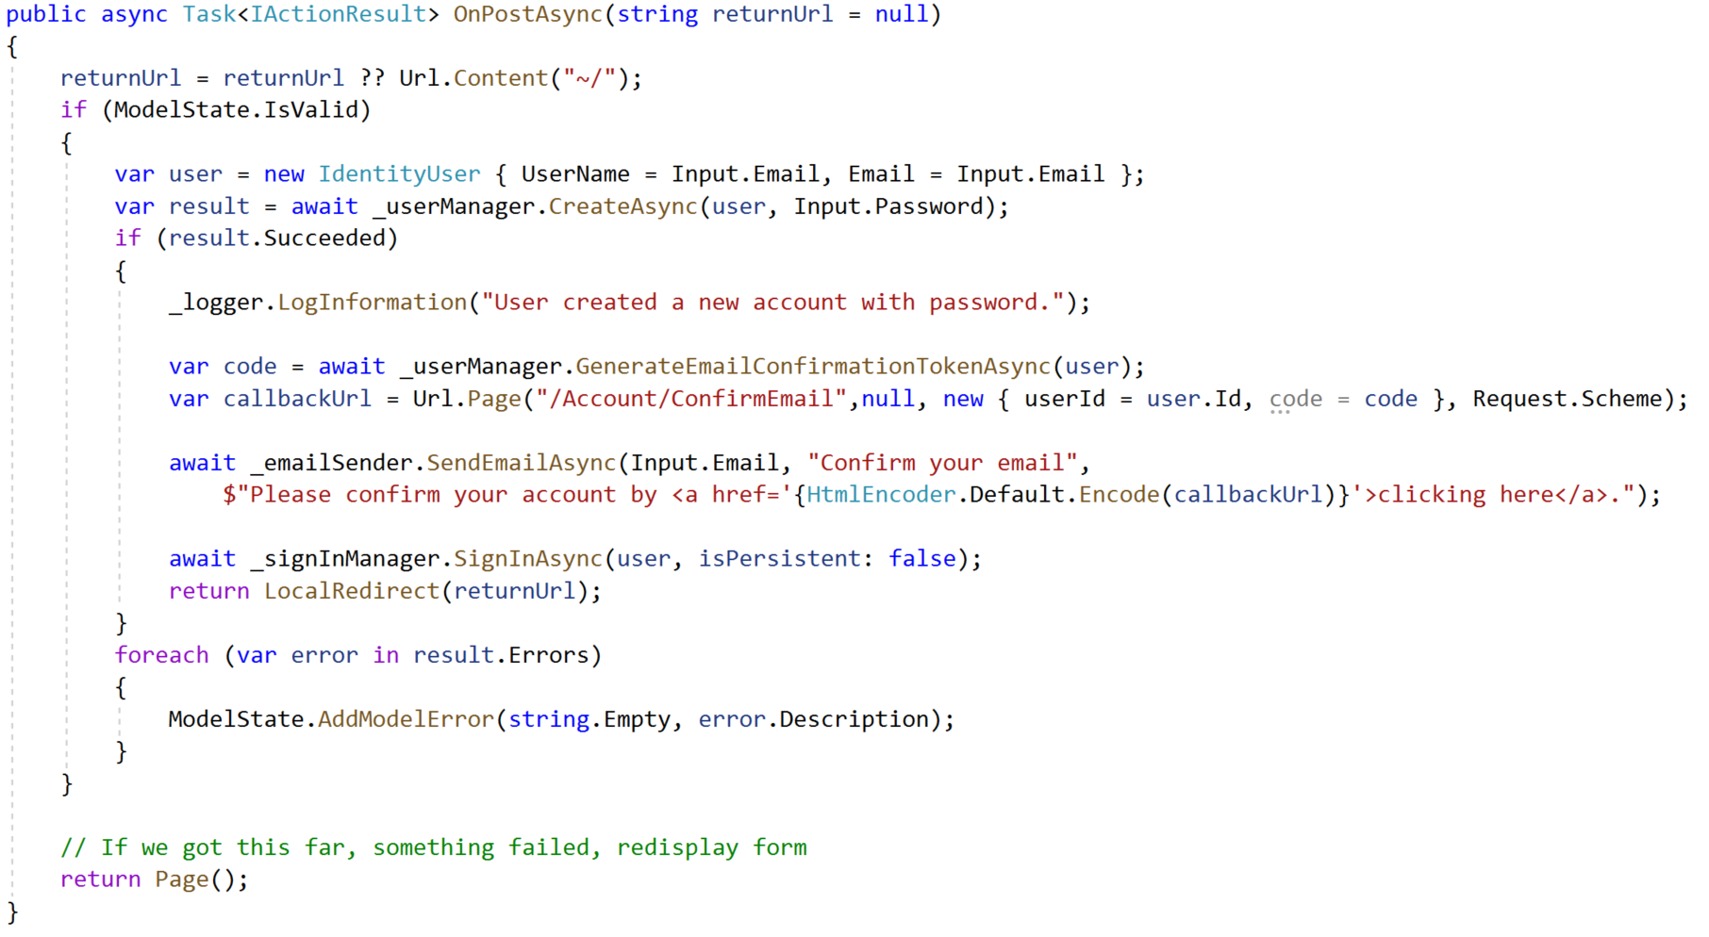
Razor Pages Template Code:

Slide 22
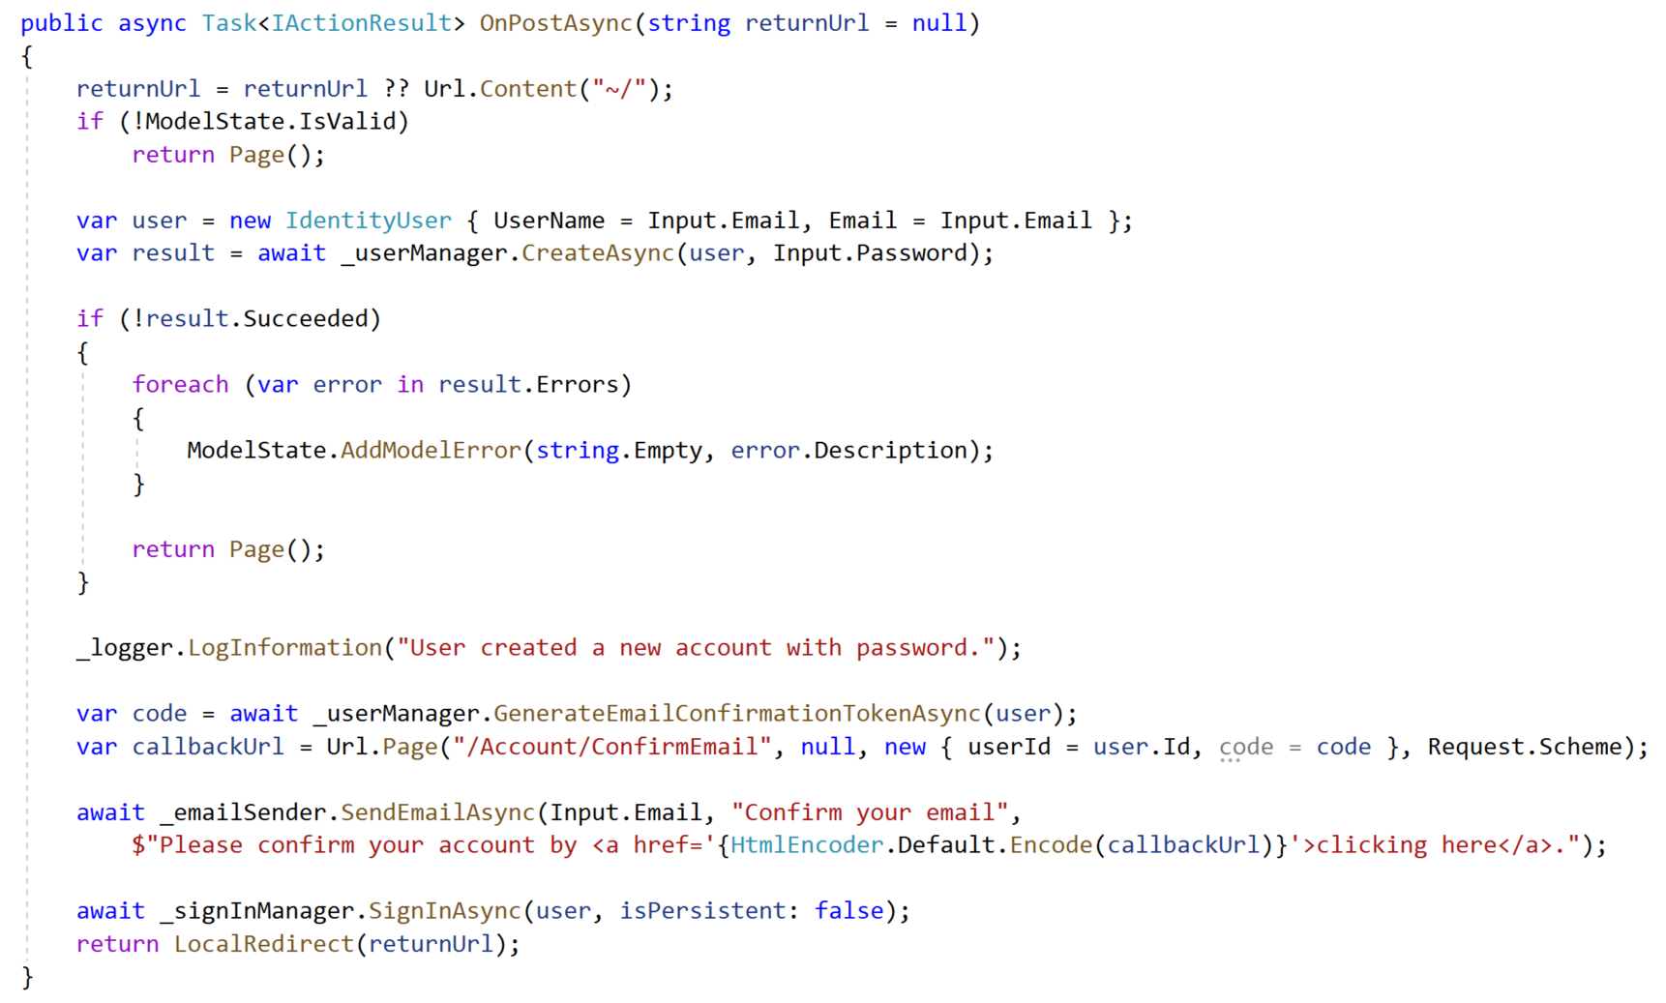
Refactored with Happy Path At The Bottom:

Slide 23
The Indentation Proclamation
The more indented your code is, the harder it is to follow
Nested if’s, nested loops, etc.
…I made this up
scottsauber

Slide 24
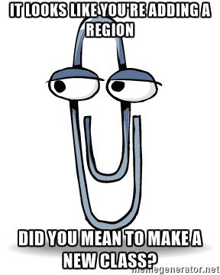
Code smells
Not hard and fast rules, just my “warning light”
Methods > 20 lines
Classes > 200 lines
Regions
You probably should’ve added a new class or method instead

Slide 25
Questions on Code Flow/Smells?

Slide 26

Validation

Slide 27
Validation – What’s wrong with OOB Options
Data Annotations
Only work well for simple scenarios
Hard to make custom ones
Hard to unit test
Separate annotations for each property
Can get “tall”
SRP violated
Model + Validation combined into one class
Writing own Custom Validation classes
Lose client-side hooks Data Annotations provides
scottsauber

Slide 28

Solution: Use FluentValidation
Fluent interface
Business rules are easy to maintain and read
Easy to show a stakeholder
Easy to test
Integrates with ModelState.IsValid
Same Client-Side validation as Data Annotations
95M downloads
https://github.com/JeremySkinner/FluentValidation
scottsauber

Slide 29
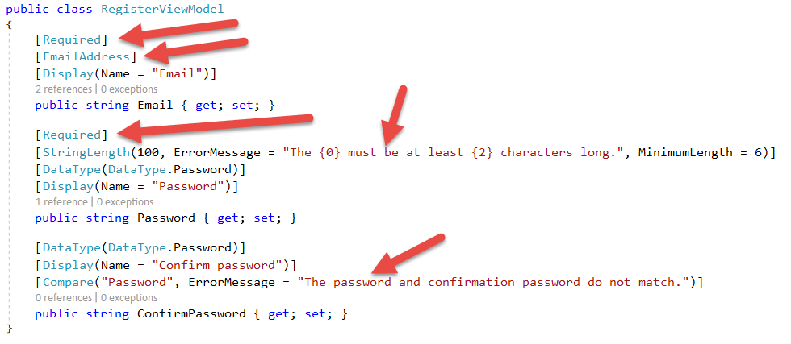
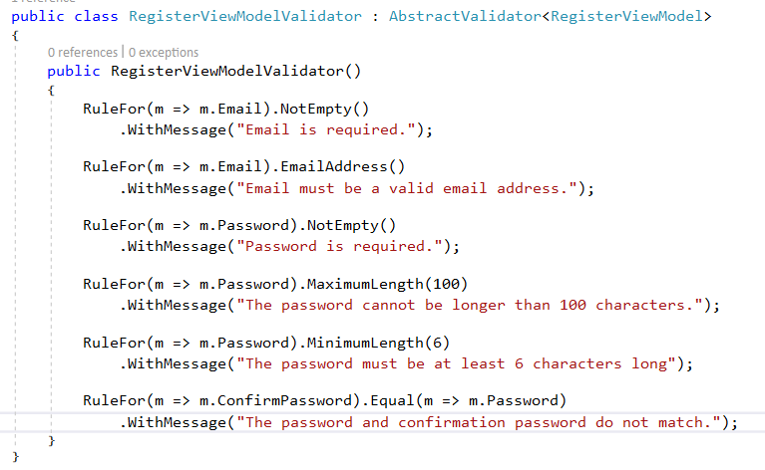
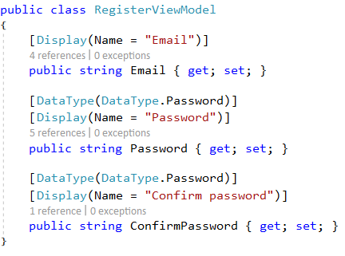
Template Code:
Refactored with Fluent Validation:

Slide 30
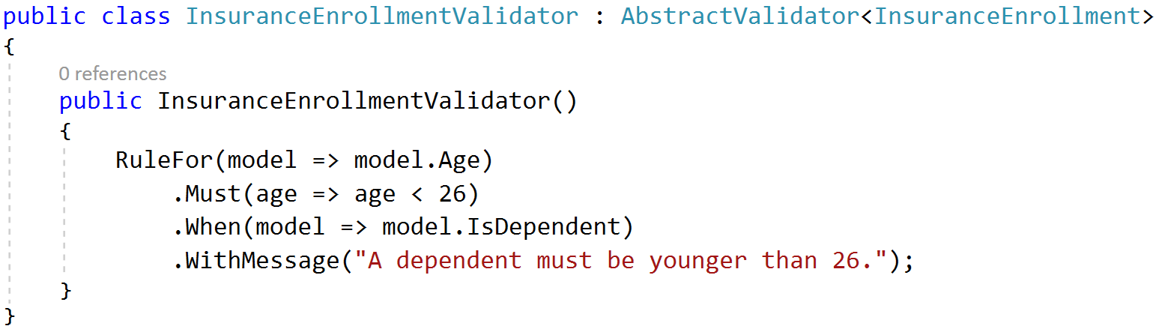
A Rule that only exists if….

Slide 31
Questions on Fluent Validation?

Slide 32

ORM’s

Slide 33

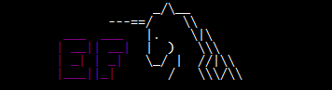
Don’t use raw ADO - Use an ORM
Entity Framework – Full ORM
Pros
Developer Productivity
Compile-time safety with LINQ Queries
Extremely quick to add new CRUD operations
Built in Unit of Work
Migration support
Cons
Less performant
Less control over the queries generated
Heavier
Dapper – Micro ORM
Pros
Performance near ADO
More control over the queries
Extremely simple to setup
Stack Overflow beta tests
Cons
SQL strings = Big column name refactorings are harder
Less features than EF
Notes:
Using an ORM will help you map to objects, which will help you make your view models

Slide 34
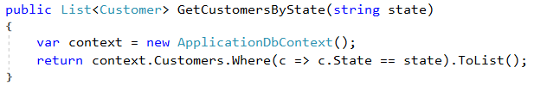
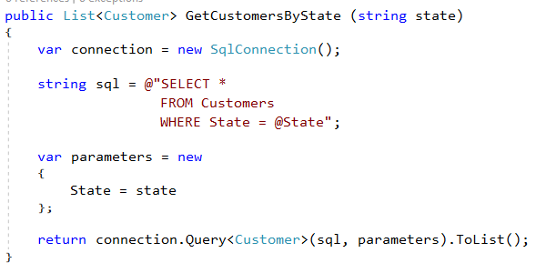
ORM usage comparison
Entity Framework:
Dapper:
Notes:
Obviously would want to inject in a SQL Connection or a DbContext here, not new up inline. But just showing you the objects both interact with. EF with DbContext and Dapper with SQL Connection.
Both manage connection life times for you. No more try/finally blocks.
Dapper more verbose and more to know about SQL, but you get better performance.
Both illustrate preventing

Slide 35
Other ORM things
Both manage connection lifetimes
Both give you SQL Injection protection
I use both depending on the job
DON’T WRITE YOUR OWN ORM
scottsauber

Slide 36
Questions on ORM’s?

Slide 37

Dependency Injection

Slide 38
Dependency Injection and IoC containers
DI/IoC helps you loosely couple your apps
Easily swap out different implementations
Switching directions
Running locally vs in the cloud
Lets you unit test anything if done correctly
I use Microsoft.Extensions.DependencyInjection
Scrutor if you want auto-registration
scottsauber

Slide 39
Common DI Pitfalls
“New Is Glue”
“Static Cling”
DateTime.UtcNow (and variants)
Instead inject in IClock or have method take in DateTime? and default to Now
scottsauber

Slide 40
Questions on Dependency Injection?

Slide 41

Automated Tests

Slide 42
Automated Testing with xUnit
You should be writing automated tests
Exposes holes in your architecture
Proven to be faster long-term
Make changes quickly and confidently because have a regression test suite
Use xUnit or NUnit
Just not MSTest which is wayyy more verbose and has less features
xUnit used by ASP.NET team
I used to use NUnit and switched to xUnit
NUnit more boilerplate
No [TestFixture] in xUnit
No [SetUp] method just use a constructor in xUnit
scottsauber

Slide 43
Problem: OOB Assertion Libraries Annoy Me
Assert.Equal(value, value)
Hard to remember that it’s Assert.Equal(expected, actual)
Yes I know analyzers are baked into xUnit to help here
Can lead to funky looking assertion failures if you flip them
scottsauber

Slide 44
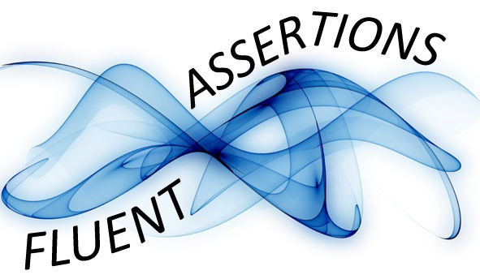
Solution: Use FluentAssertions for assertions
Adds a Should() extension method to object
result.Should().Be(0);
Easier to read than Assert.Equal(0, result);
Should().BeEquivalentTo();
actualCustomer.Should().BeEquivalentTo(expectedCustomer);
100M+ downloads
scottsauber

Slide 45


Chekhov’s Gun
scottsauber

Slide 46
Chekhov’s Gun
“Remove everything not relevant to the story. If a rifle is hanging on the wall in chapter 1, it must go off in a later chapter. Otherwise it shouldn’t be there.”
- Anton Chekhov
scottsauber

Slide 47
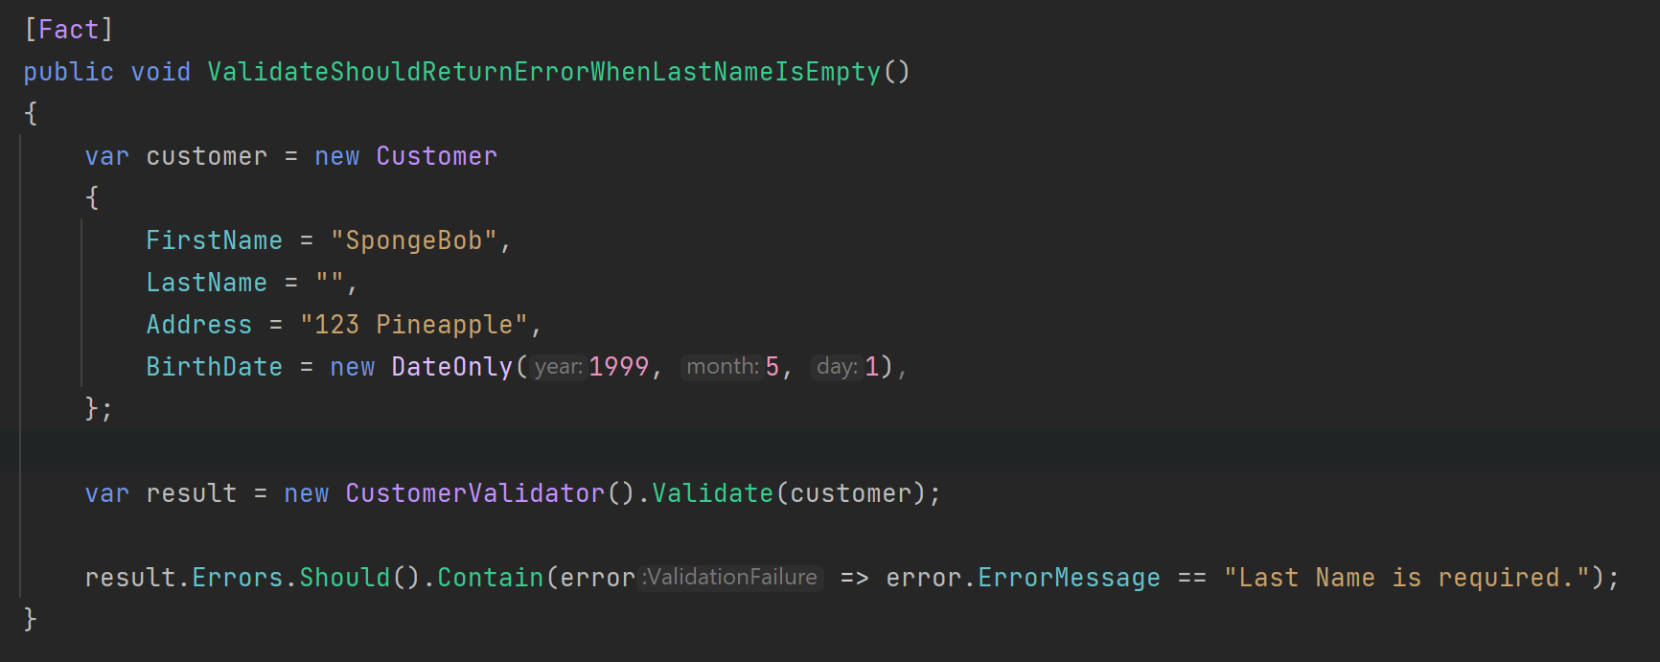
Chekhov’s Gun Applied to Arrange
scottsauber

Slide 48
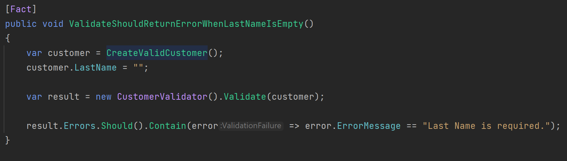
Chekhov’s Gun Applied to Arrange
scottsauber

Slide 49
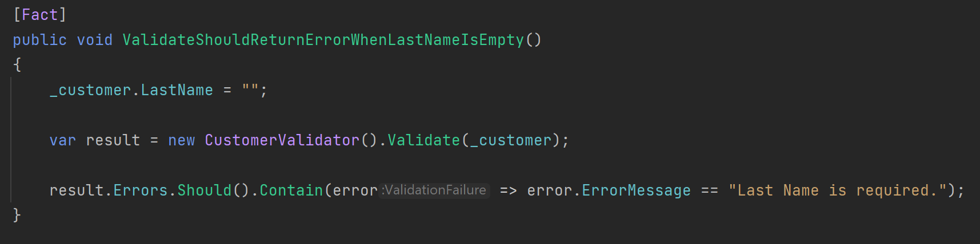
Chekhov’s Gun Applied to Arrange
scottsauber

Slide 50
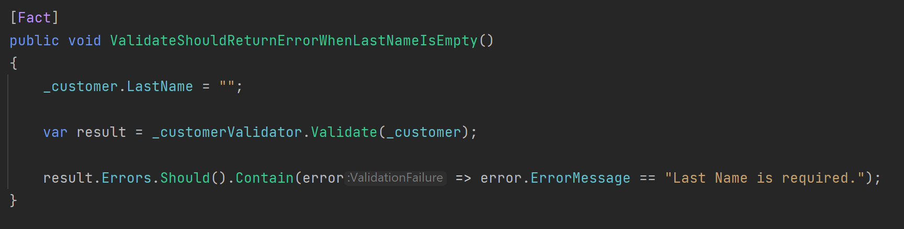
Chekhov’s Gun Applied to Arrange
scottsauber

Slide 51
Comparison
scottsauber

Slide 52
Questions on Automated Testing?

Slide 53
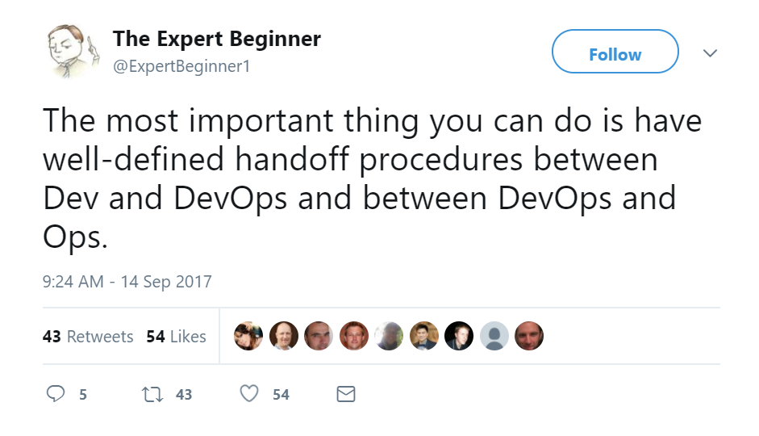
DevOps

Slide 54
What is DevOps
“DevOps is the union of people, process, and products to enable continuous delivery of value to our end users.”
- Donovan Brown

Slide 55

DevOps Pipeline

Slide 56
Continuous Integration and Delivery
Continuous Integration is a practice not a server
Build Server
Automated builds running on an independent build server
Automatically running automated tests
Creates an artifact
Continuous Delivery
Takes the artifact from the build server and deploys it to each enviornment
Automated configuration of infrastructure (Azure, AWS, GCP, on-prem, etc)
These two together will be transformational for you and your company
scottsauber

Slide 57
CI + CD enables
Consistency
Machine repeats the same steps over and over again
Consistency promotes Confidence
Passes build
Passes automated tests
Let’s deploy it to Prod!
Confidence enables agility
Mid-day deployments are no big deal
For a single app, the most I’ve seen for 2 developers is 24 deployments to Prod in 1 day
scottsauber

Slide 58
Continuous Deployment
Deploying every push to main
What’s stopping you from deploying on green?
Usually more automated tests
Add them until confidence exists
scottsauber

Slide 59
Questions on DevOps?

Slide 60

Feature Toggles

Slide 61
Feature Toggles
No long lived branches
No environment branches
Trunk Based Development
Commit to main instead!
Behind an if statement
Reduce merge conflicts
Simplest way: config files – Microsoft.FeatureManagement
appsettings.{Environment}.json
Commit to cleaning up after it’s live
De-couples deployments from releases
scottsauber

Slide 62
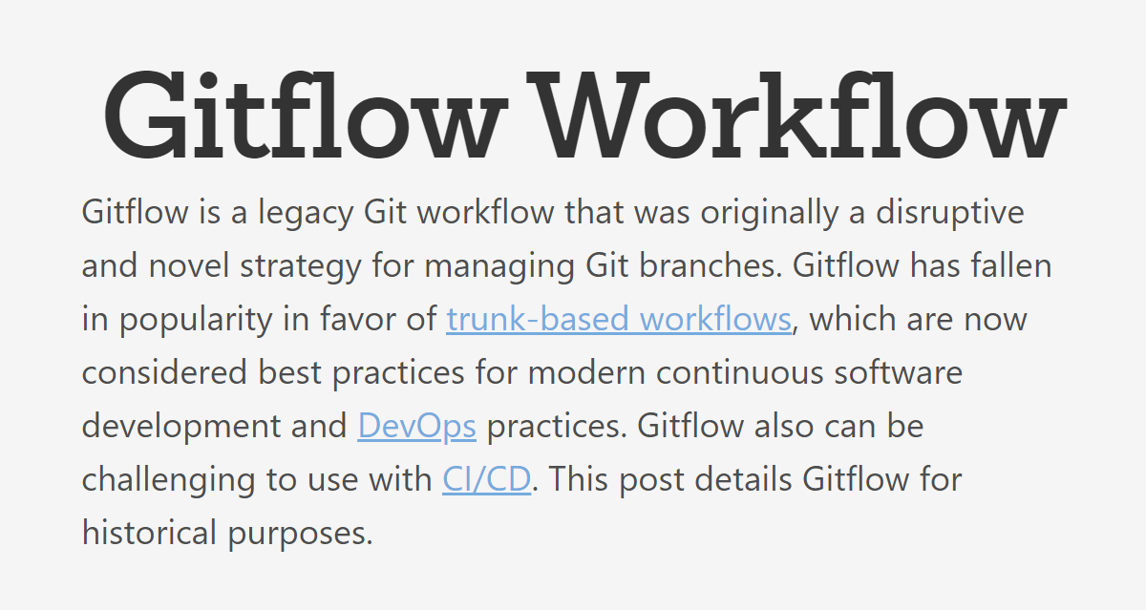
No environment branches
https://www.atlassian.com/git/tutorials/comparing-workflows/gitflow-workflow
scottsauber

Slide 63
Questions on Feature Toggles?

Slide 64
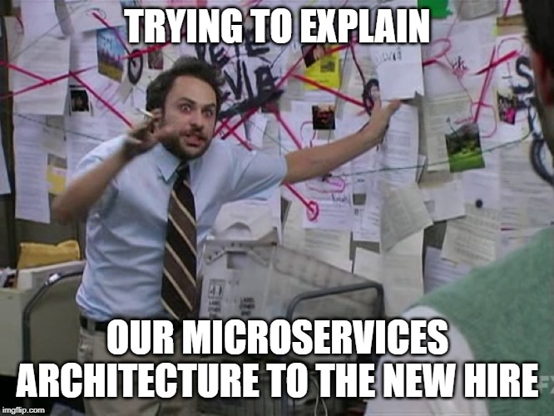
Microservices

Slide 65
What do I mean by microservices?
When I say Microservices I mean some out of process call of some sort (web service, queue, etc.)
scottsauber

Slide 66
Microservices Add Operational Complexity
Health Checks
Is it running? Are the dependencies ok?
Service Discovery
Perf is worse
Traceability with Correlation ID’s
scottsauber

Slide 67
Microservices Add Development Complexity
HTTP call (most likely) instead of a method call
If calling from C#, likely want a client library wrapper around HttpClient sending JSON
Dev environment needs multiple projects running
Cross-cutting things (users, logging, common package versions, etc.)
Network boundaries don’t magically make your code better
Did you draw the right domain boundaries?
Be wary of two-phased commits
scottsauber

Slide 68
It’s not all bad…
Benefits
Iterate on microservices separate from other app (SRP)
Reuse
Scale independently
Easy to reason about in small chunks
You are not Google/Facebook/Netflix/Amazon
Use where it makes sense:
Needs scale
High CPU usage
Isolate an annoying dependency
Separate teams
Hard costs is a priority over engineering costs

Slide 69
My favorite definition of Microservices
“Loosely coupled service oriented architecture with bounded contexts.”
- Adrian Cockroft

Slide 70
Boundaries Boundaries Boundaries
“Almost all the successful microservice stories have started with a monolith that got too big and was broken up Almost all the cases where I've heard of a system that was built as a microservice system from scratch, it has ended up in serious trouble.” – Martin Fowler
“I remain convinced that it is much easier to partition an existing, "brownfield" system than to do so up front with a new, greenfield system.” – Sam Newman

Slide 71
Questions on Microservices?

Slide 72

BONUS

Slide 73
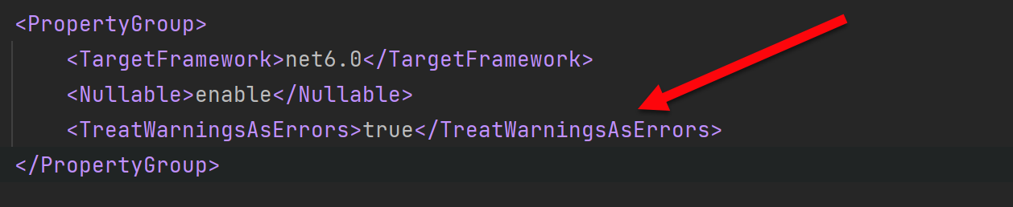
Bonus 11th Opinion
Build/Compiler warnings don’t exist in my world
Error or Nothing
scottsauber

Slide 74
Real benefits of these practices
1 web app went from deploying to Prod 20x a year to deploying to Prod over 500x a year
Faster delivery of value to users
scottsauber

Slide 75
Closing
Hope you got at least one idea out of this.
You likely don’t agree with everything I just said.
Focus on what matters
xUnit vs NUnit – who cares?
Why > How
scottsauber

Slide 76
Questions?
Slides up at scottsauber.com
scottsauber

Slide 77
Thanks!
Slides up at scottsauber.com
scottsauber

